Slide 1


Welcome
To
Embedded World

Slide 2
The Modern Day
Computer System

Slide 3

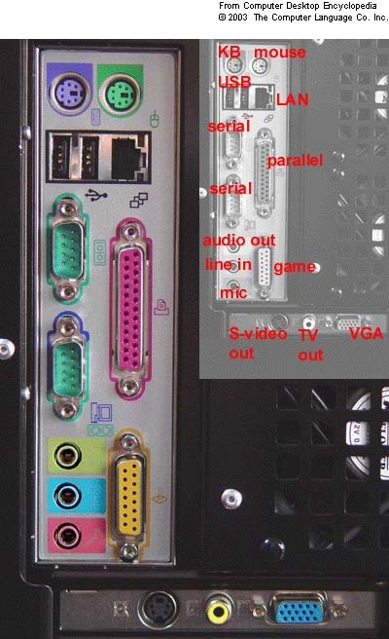
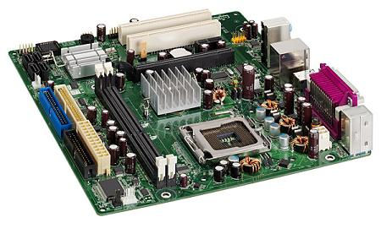
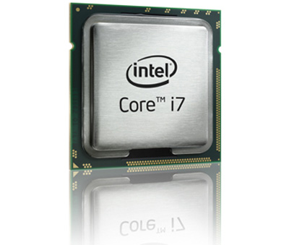
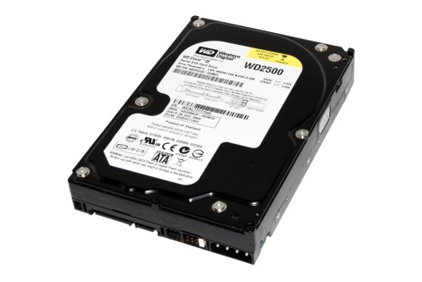
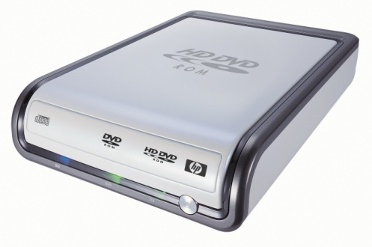
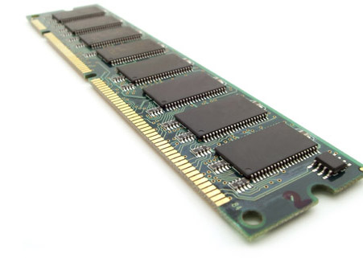

Slide 4
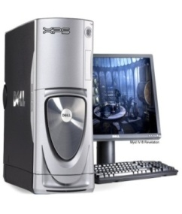
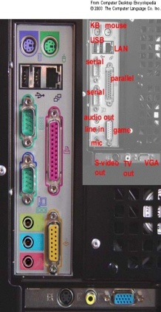
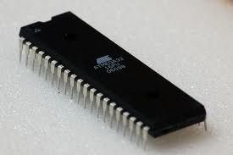
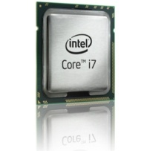

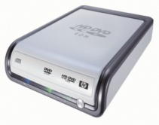
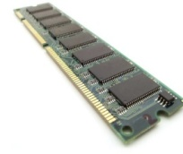
Microcontroller
Microcontroller Unit
Computer System

Slide 5
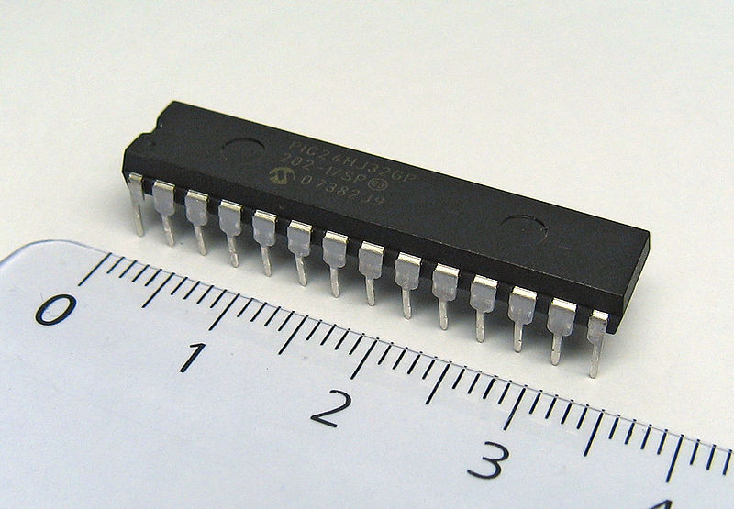

The Entire Computer in a Small Chip
Microcontroller
Computer

Slide 6
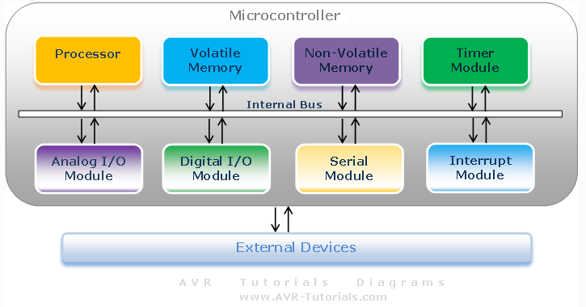
Microcontroller Structure

Slide 7
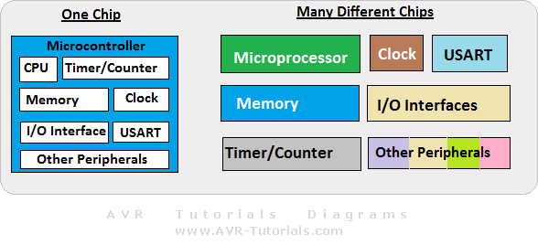
Microprocessor Vs Microcontroller
Microcontroller
Microprocessor
Entire computer on a single chip.
Central processing unit of a
computer on a single chip.
RAM, ROM,I/O, Timers serial
communication all are in built.
External memory can be used.
External RAM, ROM, I/O.
Specific purpose digital computer
General purpose digital computer
Direct hardware interface.
No direct hardware interface

Slide 8
Embedded System
Electronic autonomous system dedicated to a precise task.
Often a part within a larger device
Motor/Other Mechanical machines
Sensor
Encoder
Sensors
Other Digital/ Analog Systems
Microcontroller
Actuator

Slide 9
Some Features of Microcontrollers
Can be interfaced with
Sensors
Actuators
Encoders
Motors
ADC
other Digital/ Analog Systems
Displays, etc.

Slide 10
Some Features of Microcontrollers
Built-in peripheral features
Can be a high current sink or source.
External interrupt support.
Timer module.
Capture/compare/PWM module
USART support
LIN bus support
USB
I²C and SPI
Analog to Digital converter
Analog Comparators
Several Power-managing modes
Flexible Oscillator structures
Ethernet

Slide 11


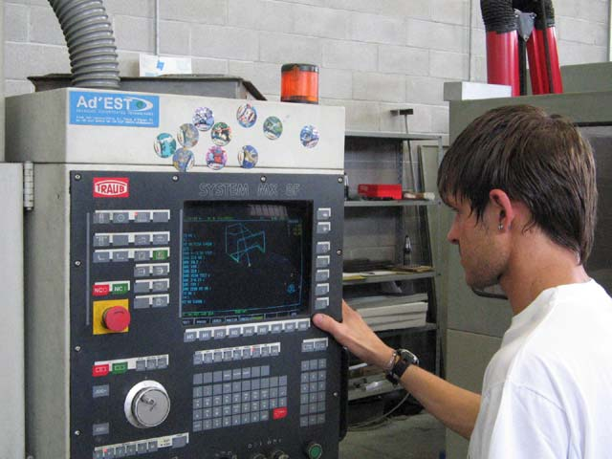
Power of Microcontrollers in Application
Microcontroller
Robotics
Cell-phones
Control System

Slide 12





Microcontroller Manufacturers
Altera
Atmel
Dallas Semiconductor
EPSON Semiconductor
Freescale Semiconductor

Slide 13





Microcontroller Manufacturers
Fujitsu
Infineon
Intel
Lattice Semiconductor
Microchip Technology

Slide 14




Microcontroller Manufacturers
National Semiconductor
NXP Semiconductors
Sony
Texas Instruments

Slide 15
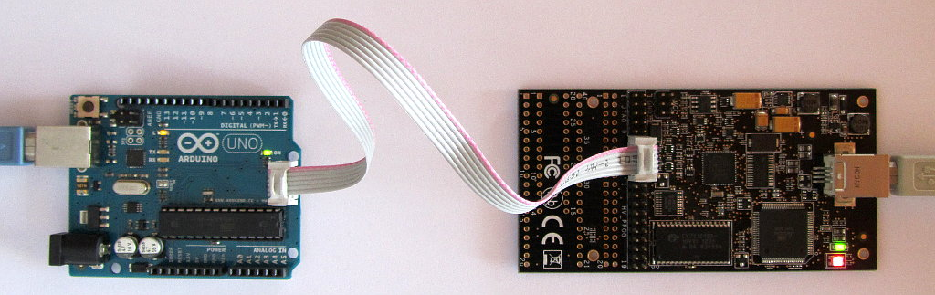
Microcontroller Programmer

Slide 16
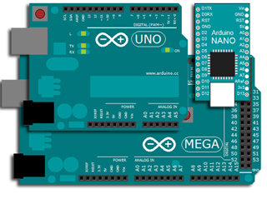
Arduino

Slide 17
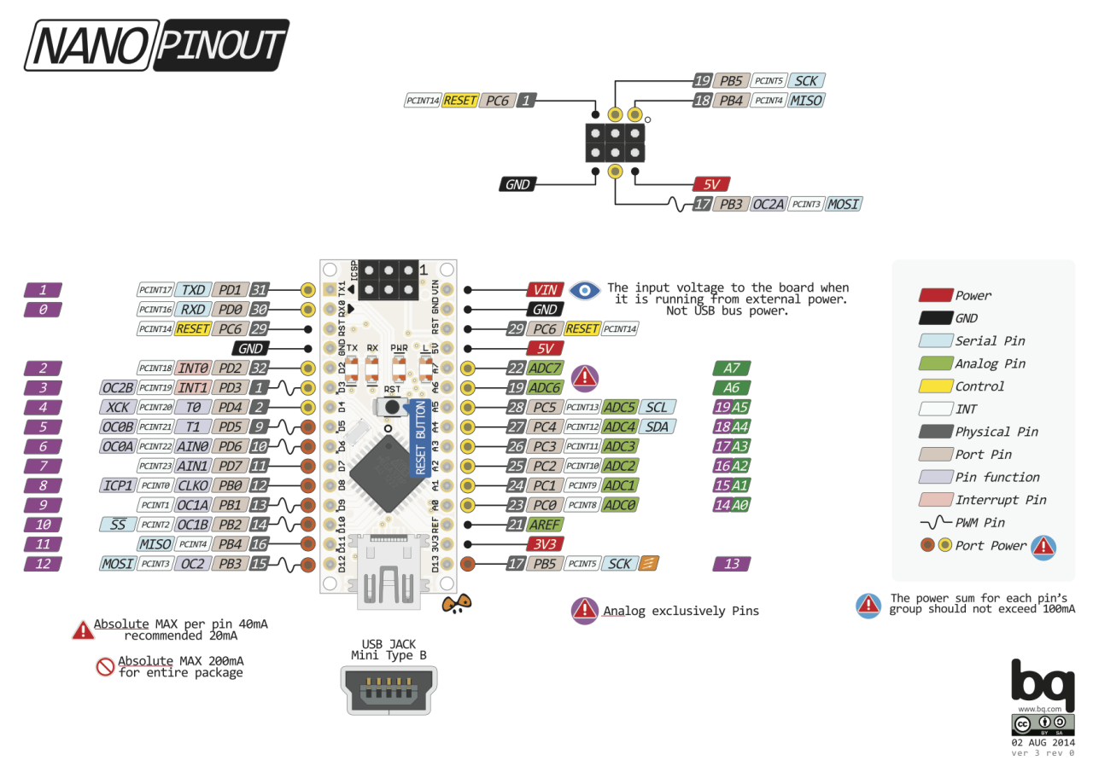
Arduino

Slide 18
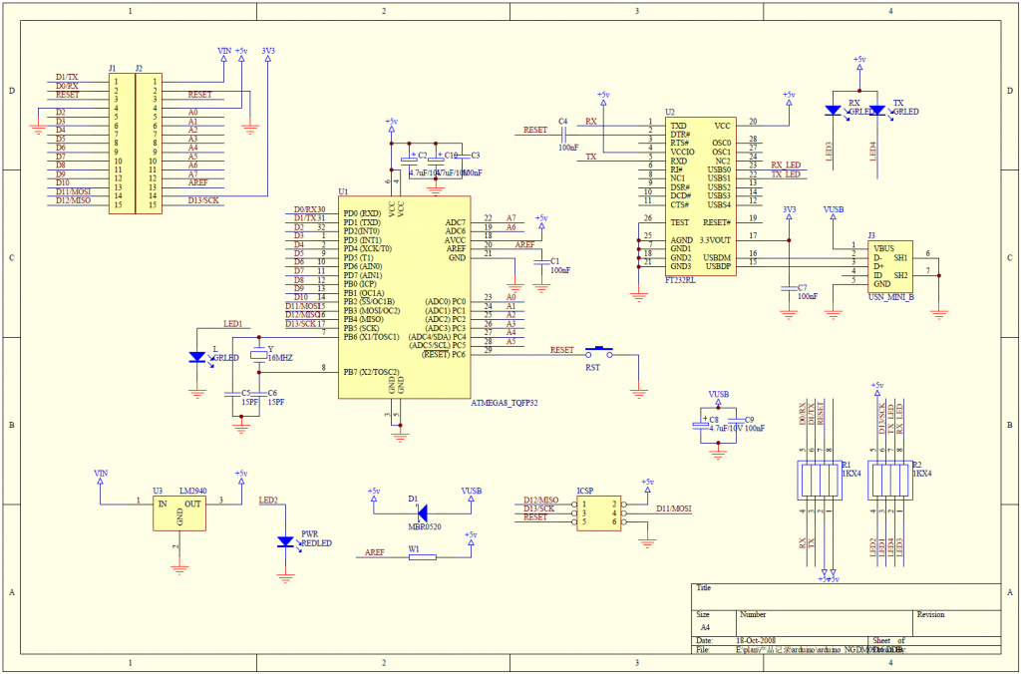
Arduino Nano
AVR 8-Bit MCU

Slide 19
Arduino Nano
USB RS-232
AVR 8-Bit MCU
External Clock
Voltage Regulator
Bootloader to program Through RS-232

Slide 20
AVR MCU
ATmega32 Datasheet
Program Counter
Register & BUS Size
Data Register
Status Register
Instruction Execution(RISC & CISC)
Add Two Values
I/O Ports(Configuring the Pin)

Slide 21
AVR MCU
Language: ASM and C
Schematic Design
IDE: Atmel Studio
LED Blink

Slide 22
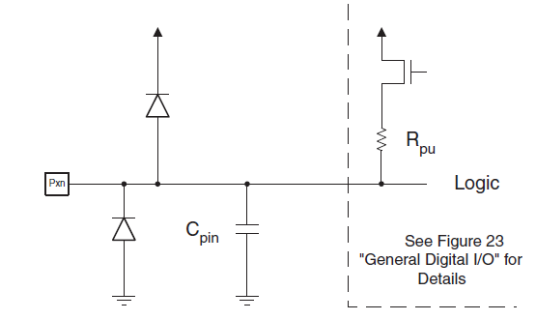
AVR I/O Block Diagram

Slide 23
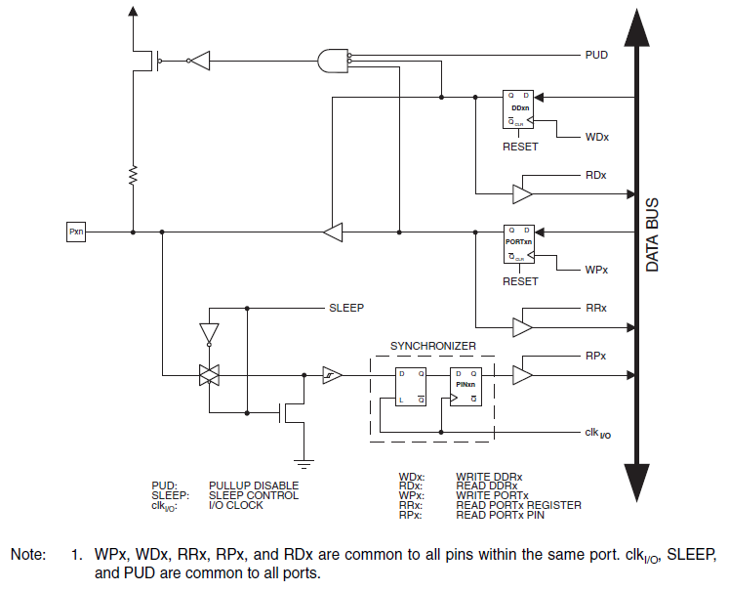
AVR I/O Block Diagram

Slide 24
I/O Registers
Port X Data Register – PORTx
Oscillator
PORTx7 6 5 4 3 2 1 PORTx0
Port X Data Direction Register – DDRx
Oscillator
DDRx7 6 5 4 3 2 1 DDRx0

Slide 25
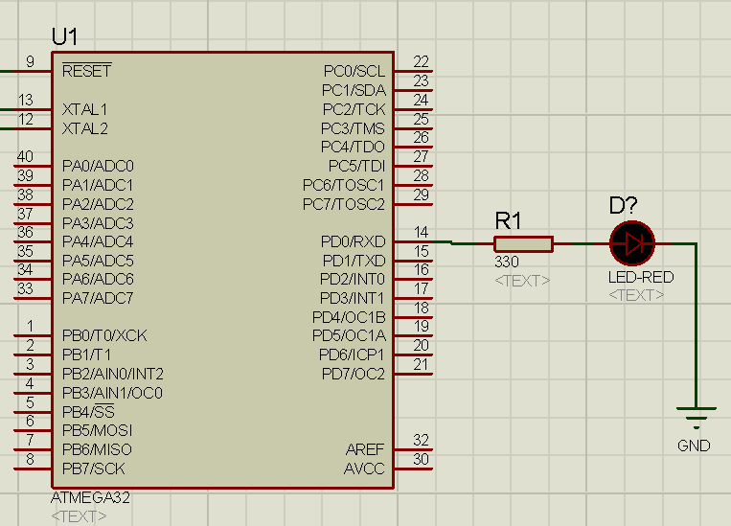
Schematic
Port X Data Register – PORTx
Oscillator
Port X Data Register – PORTx
Oscillator

Slide 26
The EERT Ltd.
Thank You

